Slide 1
Human Action Recognition Under View Change
Under the Guidance of
Dr. D.Shiloah Elizabeth
Prepared By
Group Name:msmgp
Murugappan N
Maaniccka Sentil Ma P
Mohamed Shamsudeen G

Slide 2
Project Abstract
An automotive visual surveillance system is used to detect abnormal behaviour patterns and recognize the normal ones.
video of a person is captured via JMF (both front view and the top view) then it is given to the training module.
Video is checked if it is a normal behaviour splited image is taken, whenever the action is recognized blob images are saved, and the frame counts are taken .
When anomaly is detected, alert system is generated.
The abnormal behaviour is detected by keep tracking the videos and blob frames and checking each frame values.

Slide 3
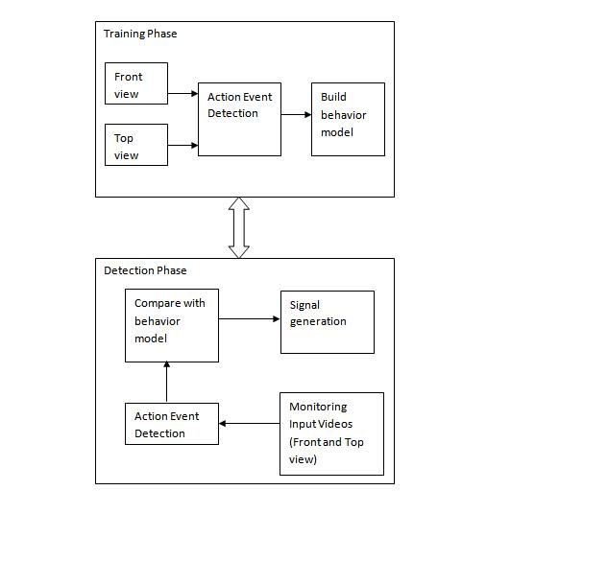
Introduction to Training and Detection Phase

Slide 4
VIDEO behaviour PROFILING FOR ANOMALY DETECTION
TRAINING PHASE
CAPTURE VIDEO
DIVIDE VIDEO INTO FRAMES
DETECT EVENT IN EACH FRAMES
IF EVENT
ALREADY
EXISTS
YES
NO
INCREMENT
OCCURENCE
STORE EVENT
SELECT NEXTFRAME
SELECT FREQUENTLY OCCURING EVENTS
BUILD BEHAVIOUR MOBEL

Slide 5
DETECTION PHASE :
CAPTURE MONITORING DATA
DIVIDE INTO VIDEO FRAMES
CHECK
EVENT EXISTS IN BEHAVOUR MODEL
NO
YES
RECOGNIZE EVENT
AS ANOMALY
RECOGNIZE EVENT
AS NORMAL
SIGNAL TO ADMIN

Slide 6
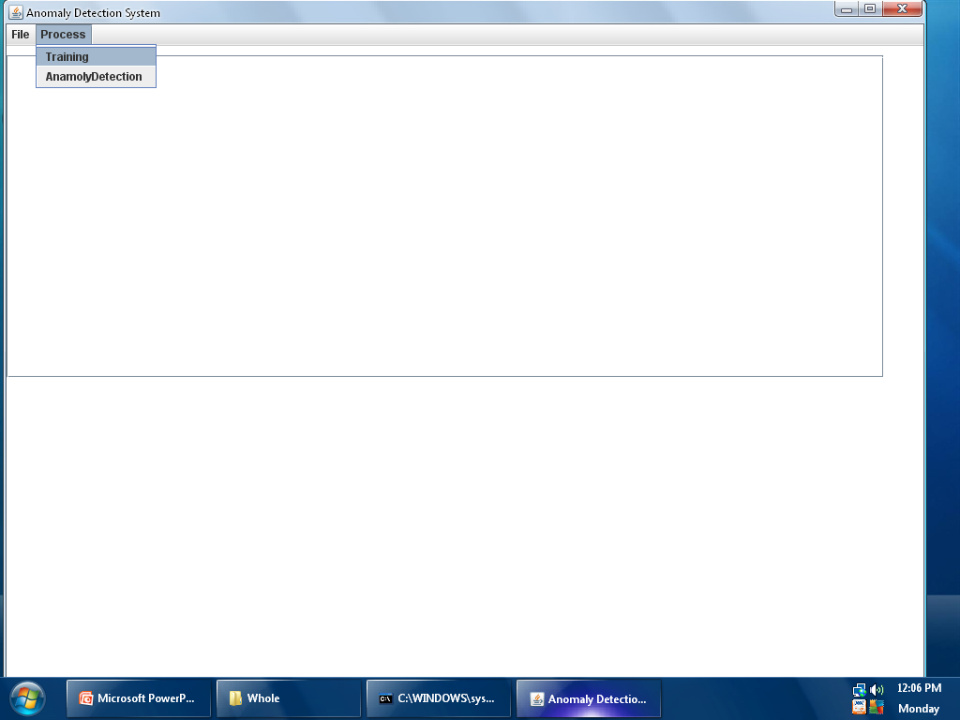
Project Snapshots : Introduction

Slide 7
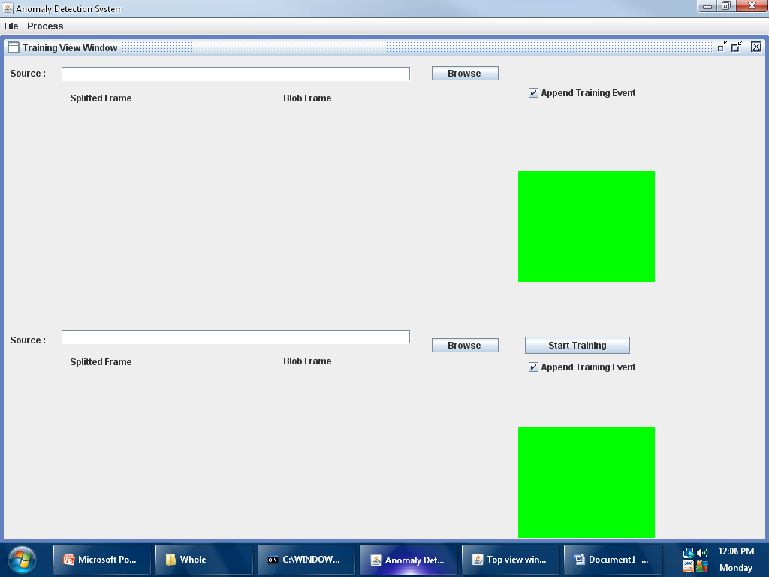
Training View Window

Slide 8
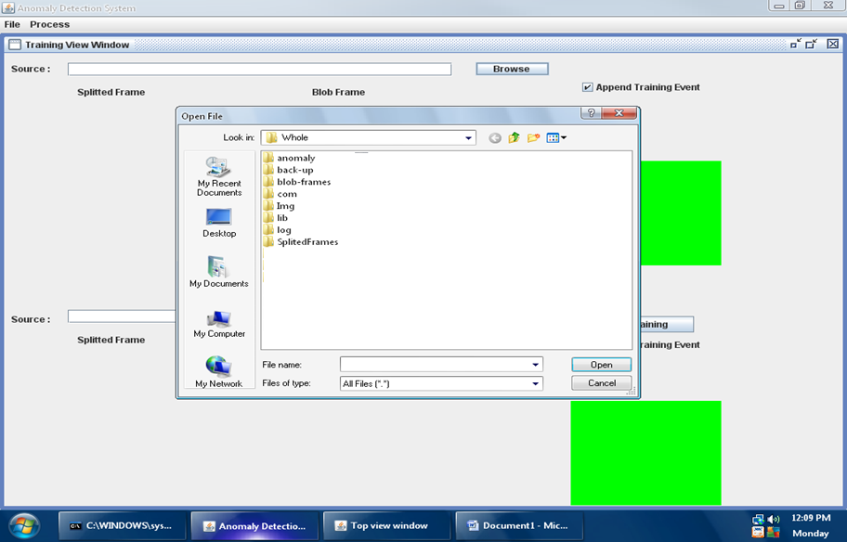
Open Video File

Slide 9
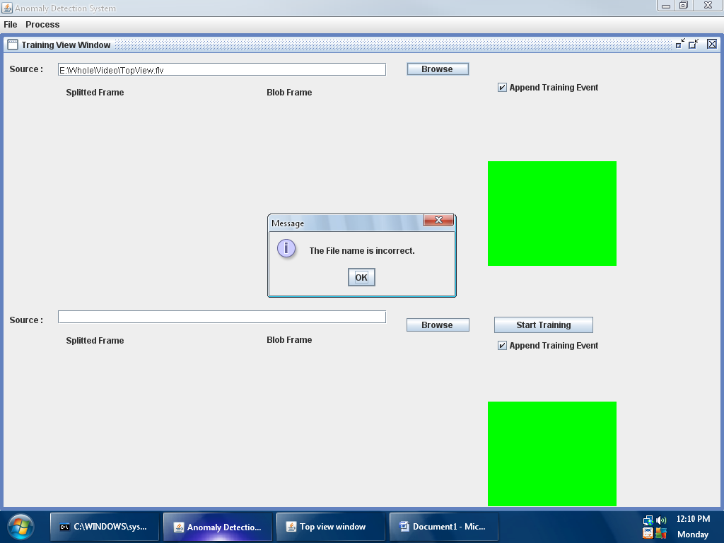
Validations To avoid run-time exceptions validations are preformed and only .avi file format is supported

Slide 10
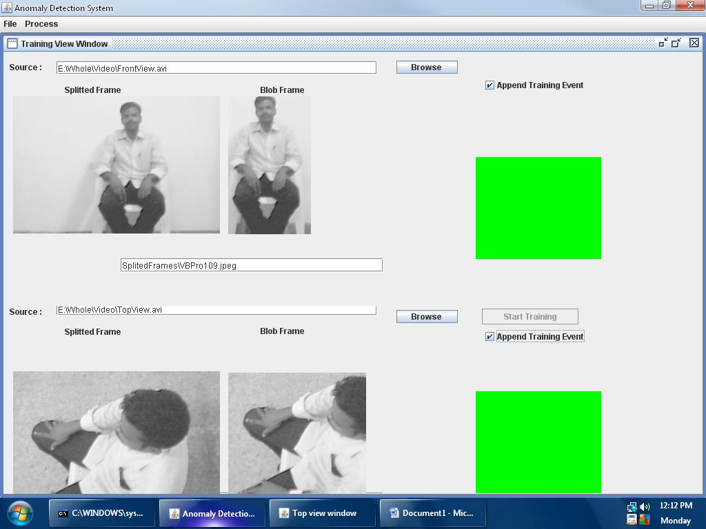
Implementation of Behaviour Training

Slide 11
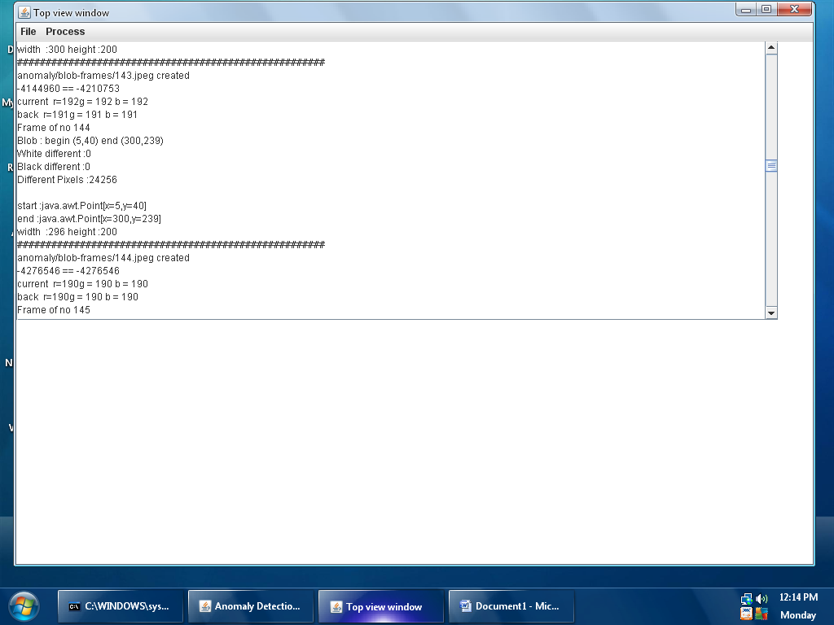
Data Extracted from Training Phase

Slide 12
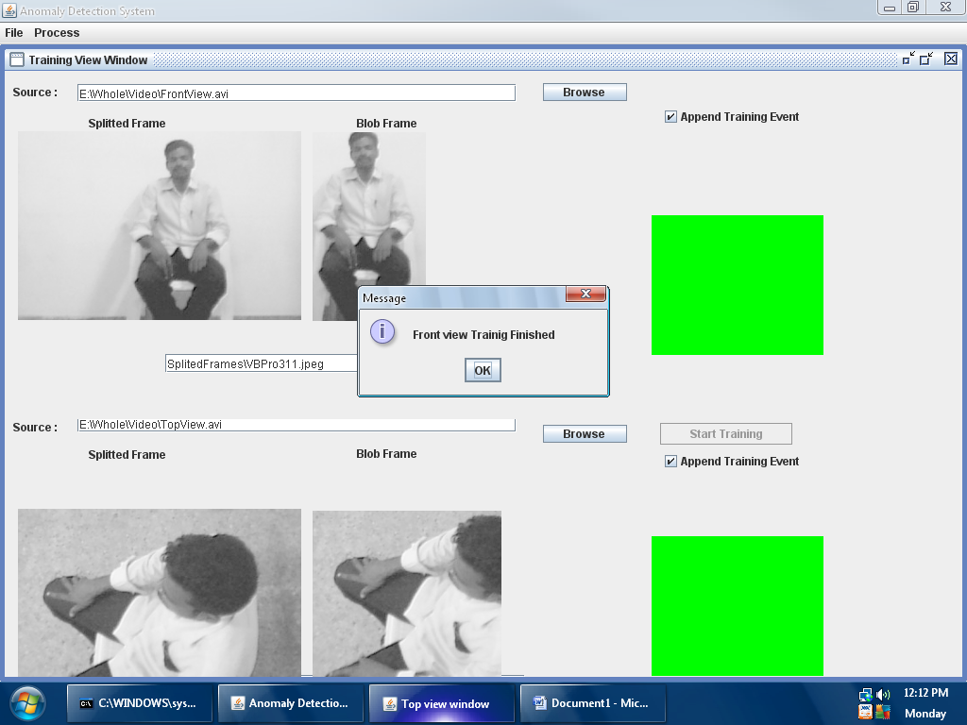
Completion of Front view Training

Slide 13
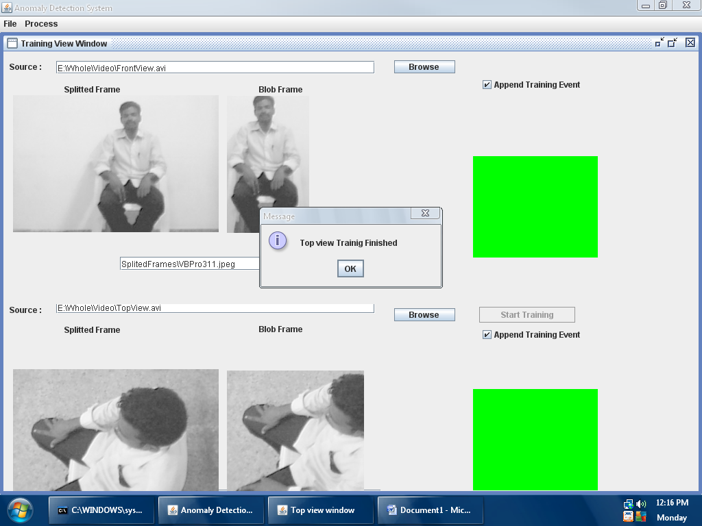
Completion of Top view Training

Slide 14
Work completed at End of Training Phase
VIDEO SEGMENTATION
Video Segmentation involves spitting the input video from the surveillance camera into various sequence of frames with help of Java Media Framework.
Video can be simply sliced into overlapping segments with a fixed time duration.
EVENT BASED BEHAVIOUR REPRESENTATION
Extraction of BLOB image from the independent spitted frame of the video an identify the foreground and background pixel of a frame and
Background model stores the values of a particular pixel which corresponds to background colors.
Pixel change history(PCH) is represented for a pixel.
Similar foreground pixels are grouped to form a blob.
A behaviour pattern is represented as a sequence of various events.

Slide 15
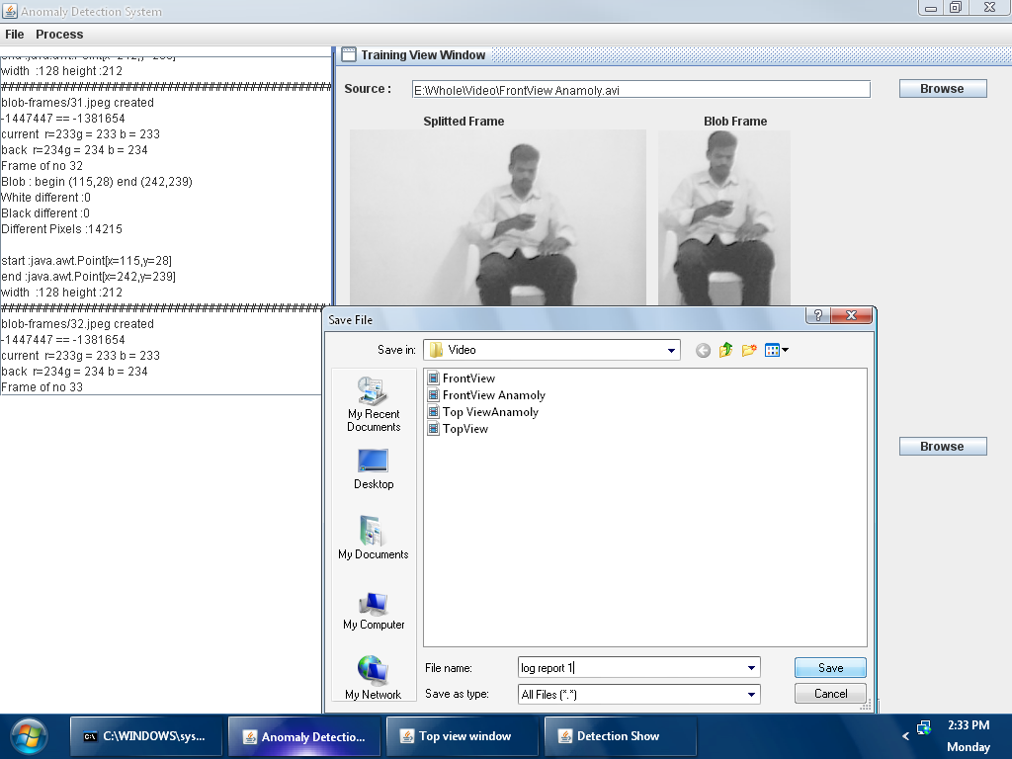
Generation of Data Report All the data extracted from the BLOB image can be saved to a txt file that can be used as a Data Report for further analysis in future.

Slide 16
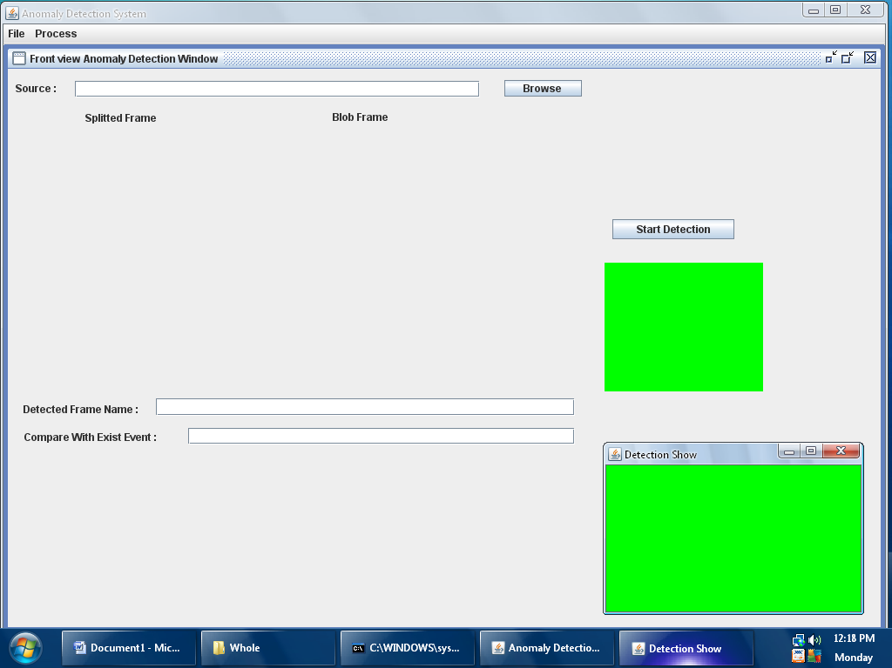
Anomaly Detection System

Slide 17
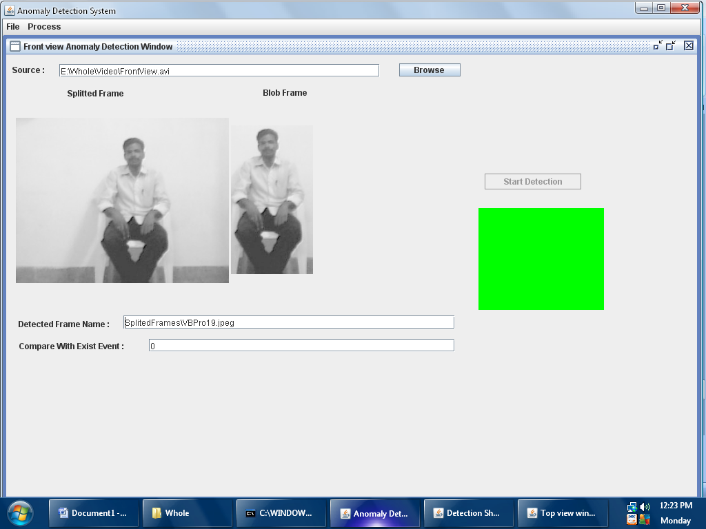
Anomaly Detection – Front View
Green Light displayed for an already trained Front View video when the current video is compared with the stored video in system and corresponding Frame Number detected

Slide 18
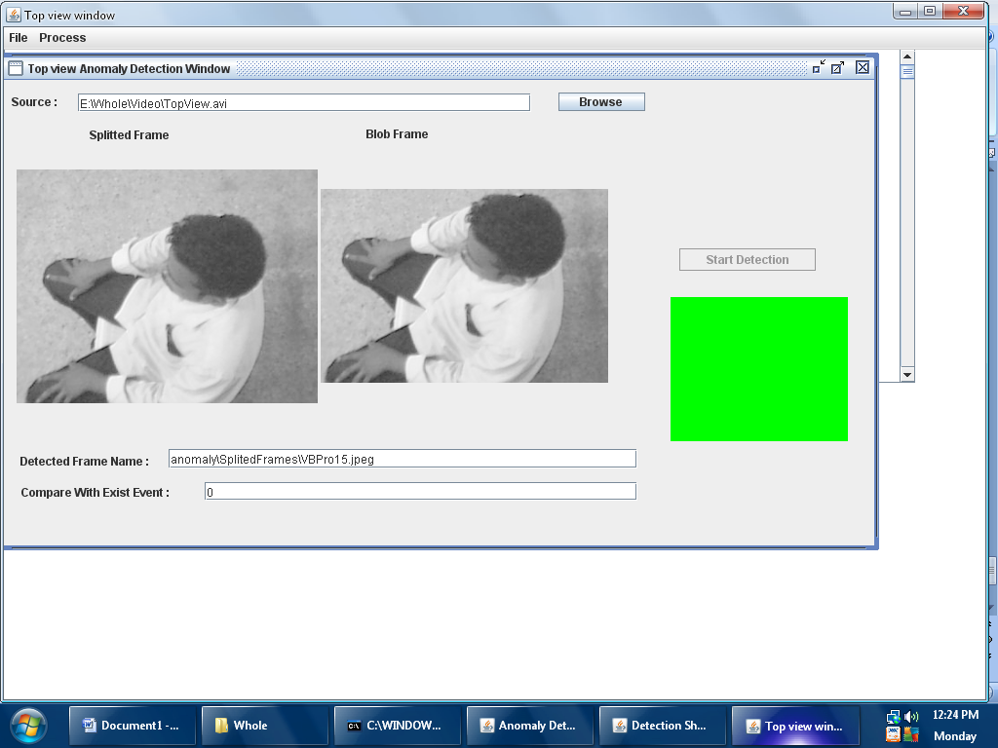
Anomaly Detection – Top View
Green Light displayed for an already trained Top View video when the current video is compared with the stored video in system and corresponding Frame Number detected

Slide 19
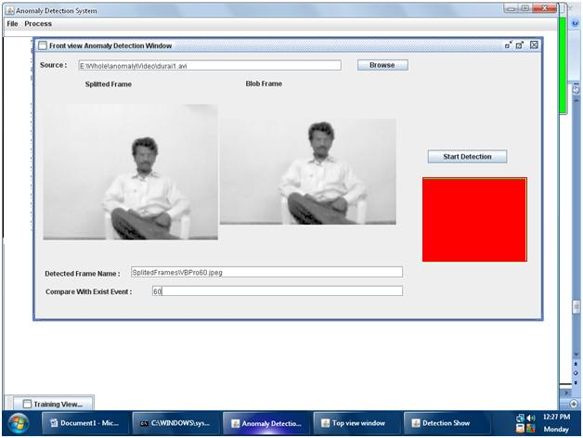
Anomaly Detection
When a new video is detected for anomaly, a mismatch occurs during comparison as there is no previously stored behaviour pattern and Red Displayed.
Immediately anomaly is informed to the admin who will do the next required action.

Slide 20
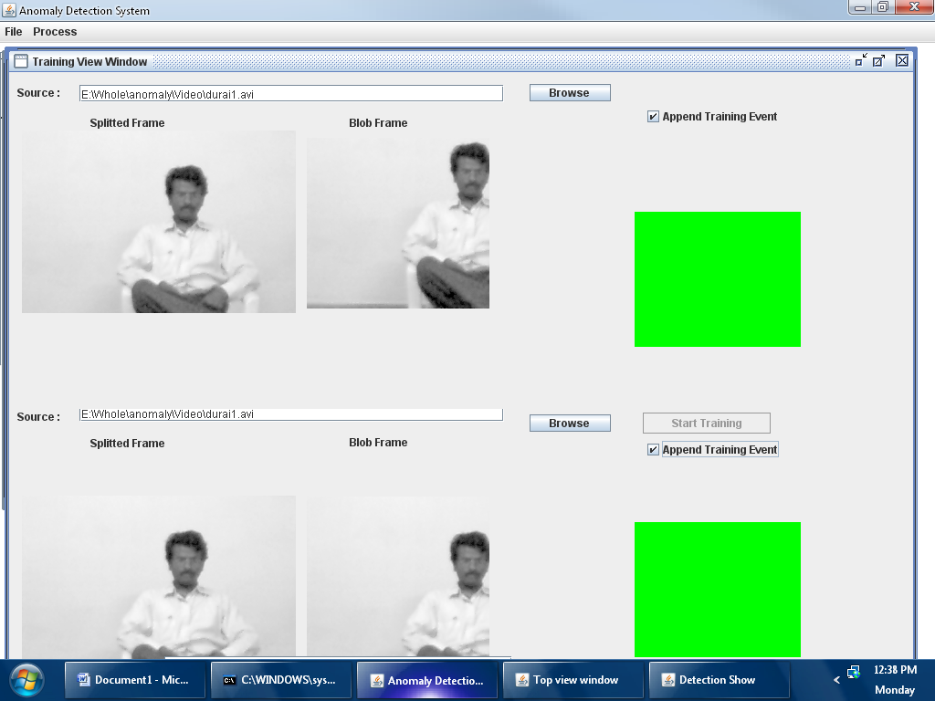
Training New Video The untrained video with anomaly is now trained to our system so that next time when the system encounters this video Error signal is not generated

Slide 21
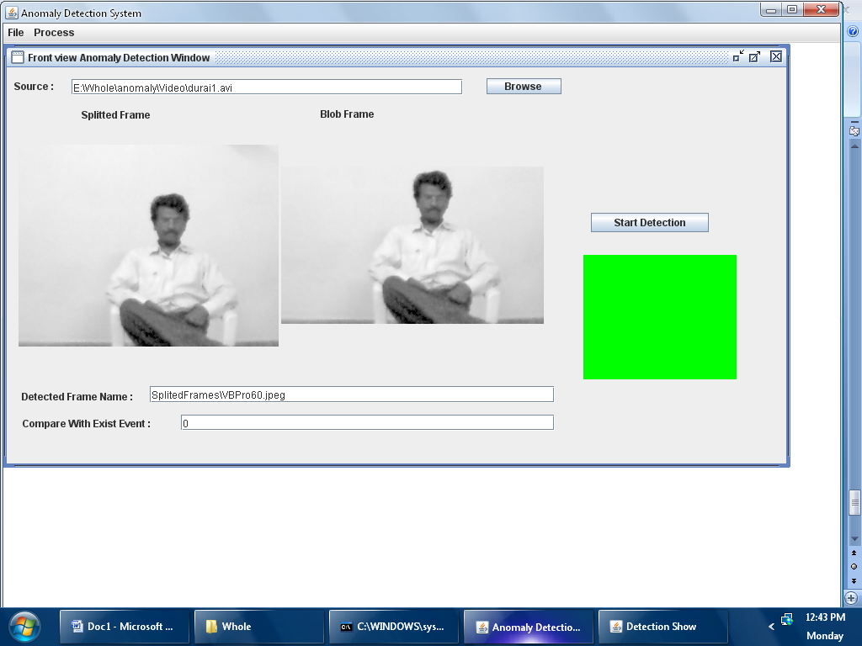
Anomaly Detection (Cont.)

Slide 22
REFERENCES
[1] T. Moeslund, A. Hilton, and V. Kruger, “A Survey of Advances in Vision-Based Human Motion Capture and Analysis,” Computer Vision and Image Understanding, vol. 103, nos. 2-3, pp. 90-126, Nov. 2006.
[2] L. Wang, W. Hu, and T. Tan, “Recent Developments in Human Motion Analysis,” Pattern Recognition, vol. 36, no. 3, pp. 585-601, Mar. 2003.
[3] A. Bobick and J. Davis, “The Recognition of Human Movement Using Temporal Templates,” IEEE Trans. Pattern Analysis and Machine Intelligence, vol. 23, no. 3, pp. 257-267, Mar. 2001.
[4] D. Weinland, R. Ronfard, and E. Boyer, “Free Viewpoint Action Recognition Using Motion History Volumes,” Computer Vision and Image Understanding, vol. 103, nos. 2-3, pp. 249-257, Nov. 2006.
[5] T. Syeda-Mahmood, M. Vasilescu, and S. Sethi, “Recognizing Action Events from Multiple Viewpoints,” Proc. IEEE Workshop Detection and Recognition of Events in Video, pp. 64-72, 2001.

